Slide 1


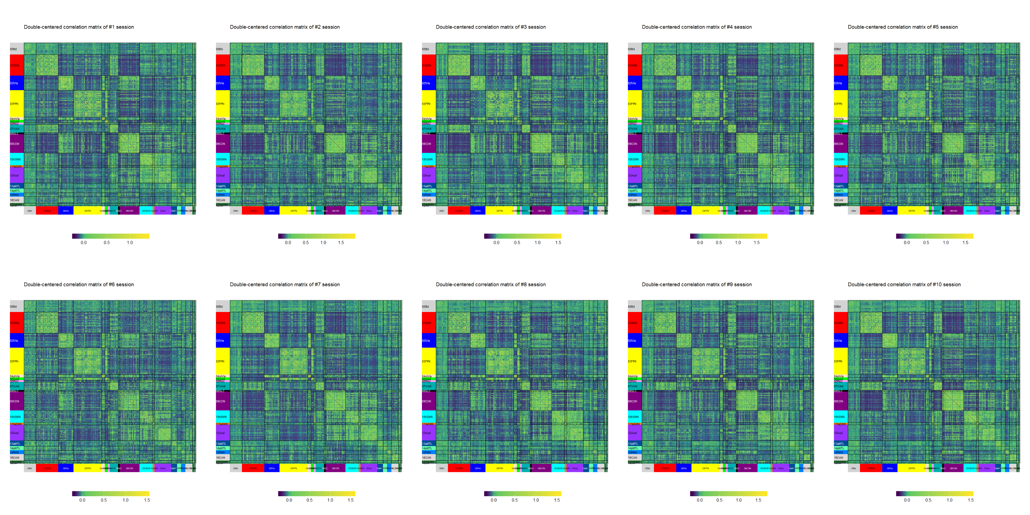
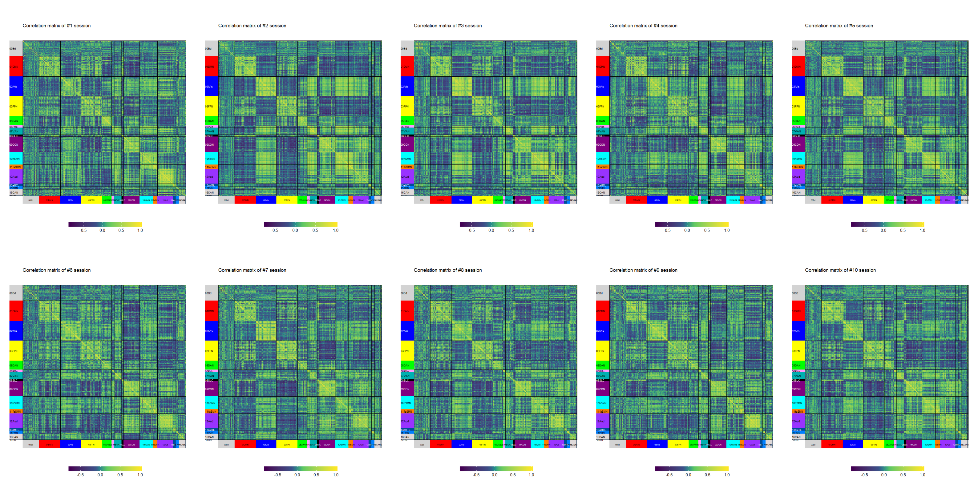
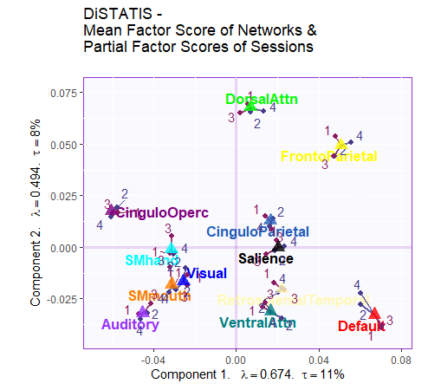
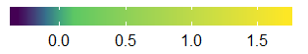
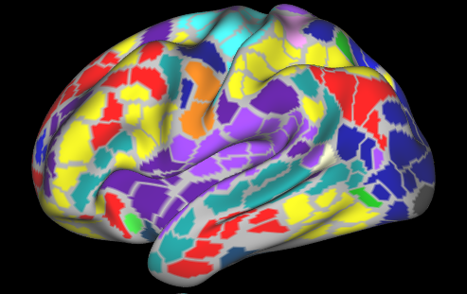
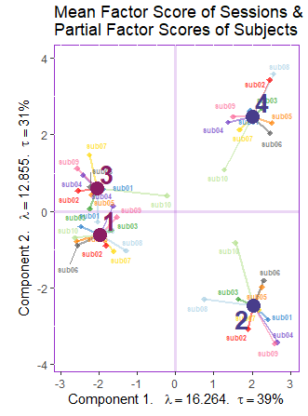
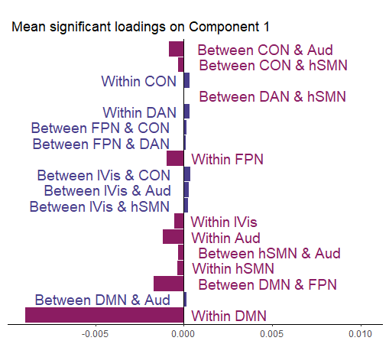
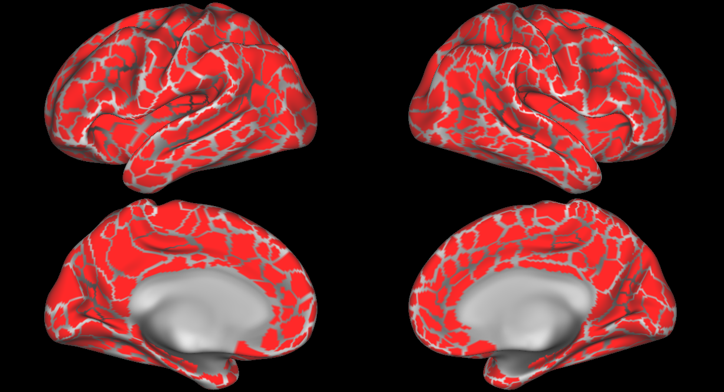
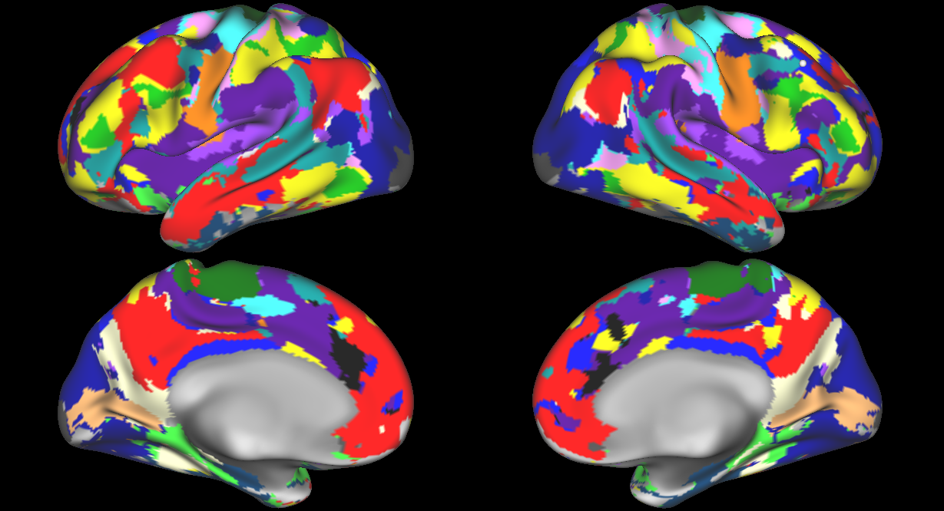
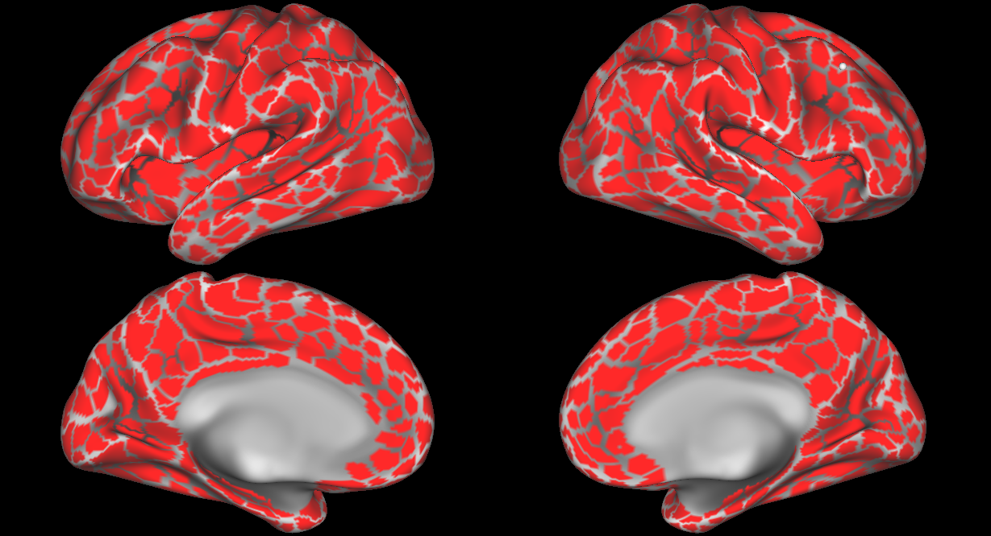
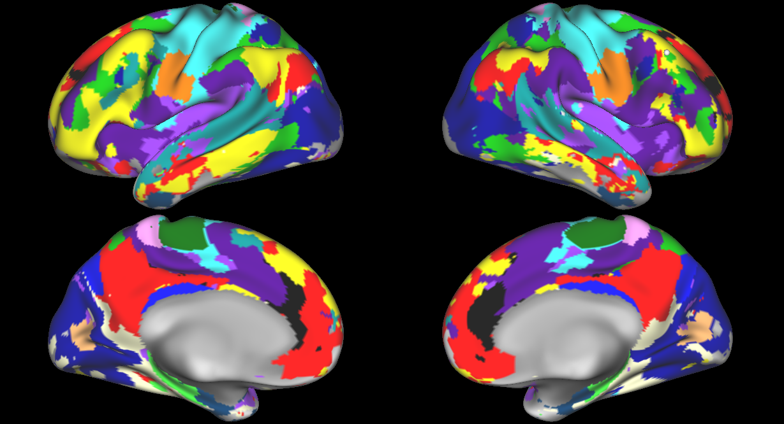
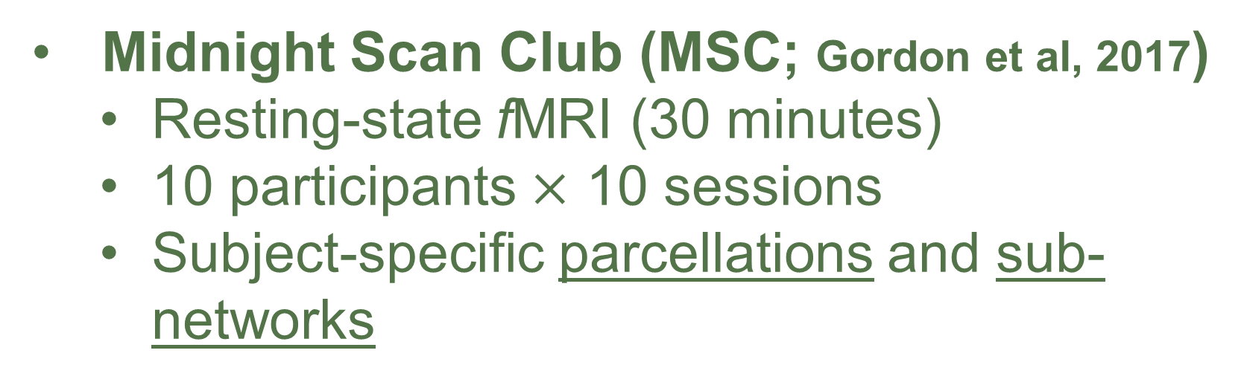
A multivariate approach to analyze connectivity matrices with individual-specific parcellation
Ju-Chi Yu¹, Micaela Chan^{1,2}, Han Liang^{1,2}, Phillip Agres^{1,2} & Hervé Abdi¹
1. School of Behavior and Brain Sciences, the University of Texas at Dallas; 2. Center of Vital Longevity, the University of Texas at Dallas
Ju-Chi.Yu@utdallas.edu, mchan@utdallas.edu, Liang.Han@utdallas.edu, Phillip.Agres@utdallas.edu, herve@utdallas.edu
1. Introduction
3. Examples of connectivity matrices
5. Simulations
Background
Current resting-state fMRI (rsfMRI) analysis derives subject-specific parcellations and sub-networks.
Standard approaches for rsfMRI:
Graph/network analysis accommodates different numbers of parcels/sub-networks.
Requires correction for multiple comparisons when examining sub-networks.
Multivariate analysis (e.g., MDS, DISTATIS) requires the same number of parcels/sub-networks.
Usually achieved by using a common template.
Biased against individuals who vary most from the target template.
These problems are particularly severe for studies involving subjects that exhibit larger variance in brain structure and function.
Aim
To develop a new approach to accommodate different numbers of parcels and sub-networks.
MSC01 (Sessions 1-5)
Sessions selection
4 sessions from MSC were kept
Only Sessions 2 and 4 were simulated
Simulating aging effect
A decrease within DMN
An increase between DMN and FPN
An increase between DMN and DAN
MSC07 (Sessions 1-5)
Default (DMN)
Common Sub-networks
6. Results
Ventral attention
Visual
Frontal-parietal control (FPN)
Cingulo-opercular control
Auditory
Dorsal Attention (DAN)
Hand somato-motor
Mouth somato-motor
Select common networks across participants
Keep only positive correlation
Z-transformed correlation
Scale
4. Multiple factor analysis
Parcel’s mean time series during resting-state scan
Cross correlation between parcels
Fisher’s Z-transformed
Frames
Session 1
Session 2
…
…
…
…
Session 10
Simulated sessions
2. Resting-state data set
Midnight Scan Club (MSC; Gordon et al, 2017)
Resting-state fMRI (30 minutes)
10 participants $×$ 10 sessions
Subject-specific parcellations and sub-networks
…
…
…
…
Session 1
Subj 1
Subj 2
Subj 3
…...
Subj N
Session 2
PCA
Parcellation
Sub-networks
Parcellation
Sub-networks
…
Session 10
MSC01
MSC07
➗ 𝛿’₁
➗ 𝛿’₁
Normalize between/within edge block with its first singular value
Parcel’s mean time series during resting-state scan
Cross correlation between parcels
The columns are grouped by their edge types (i.e., between- or within-network edges).
First singular value of each block equals 1
Equalizes block effects
Fisher’s Z transformation
Frames
Extract time series and create correlation matrix for each session of each subject

